Slide 1
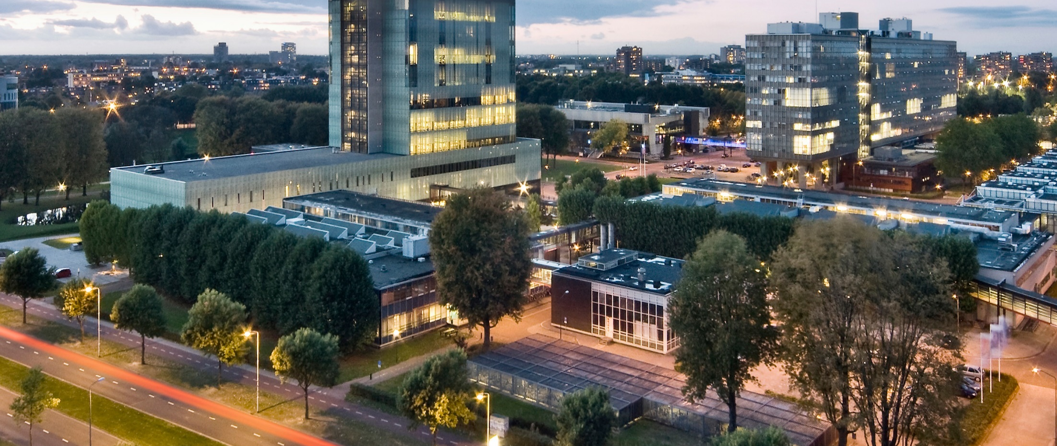
Golden Ratio
DAY3-CALCULUS-EMBROIDERY-CARDIOID
Prof. dr. ir. Loe Feijs
Department of Industrial Design, TU Eindhoven

Slide 2
Resources
Processing3, please install from
https://processing.org/download/
Github, digital-craftmanship’s repository GOLDEN-RATIO
this powerpoint (.pptx)
cardioid2019.pde
github.com/digital-craftsmanship/GOLDEN-RATIO/tree/master/DAY3-CALCULUS-EMBROIDERY-CARDIOID
External link, Wolfram’s MathWorld on cardioid
http://mathworld.wolfram.com/Cardioid.html

Slide 3
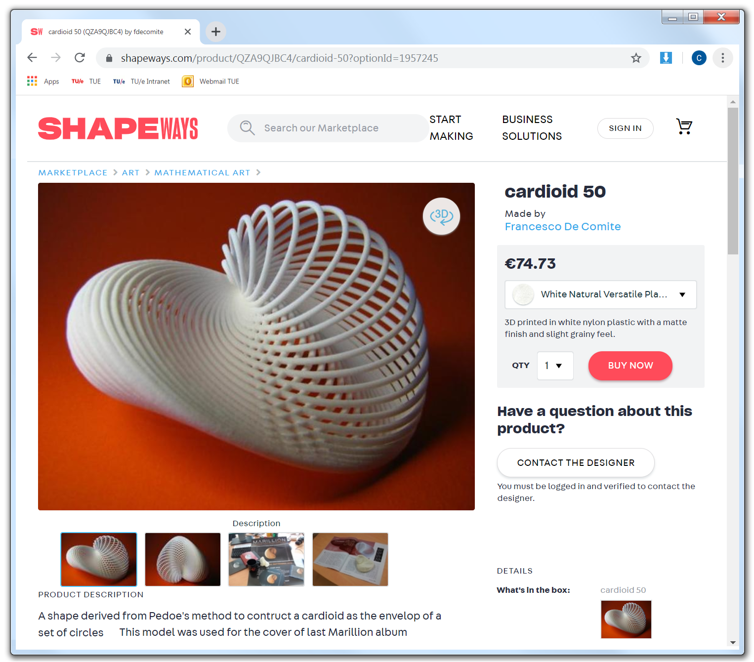

Inspiration: Franscesco de Comité, shapeways’ website

Slide 4
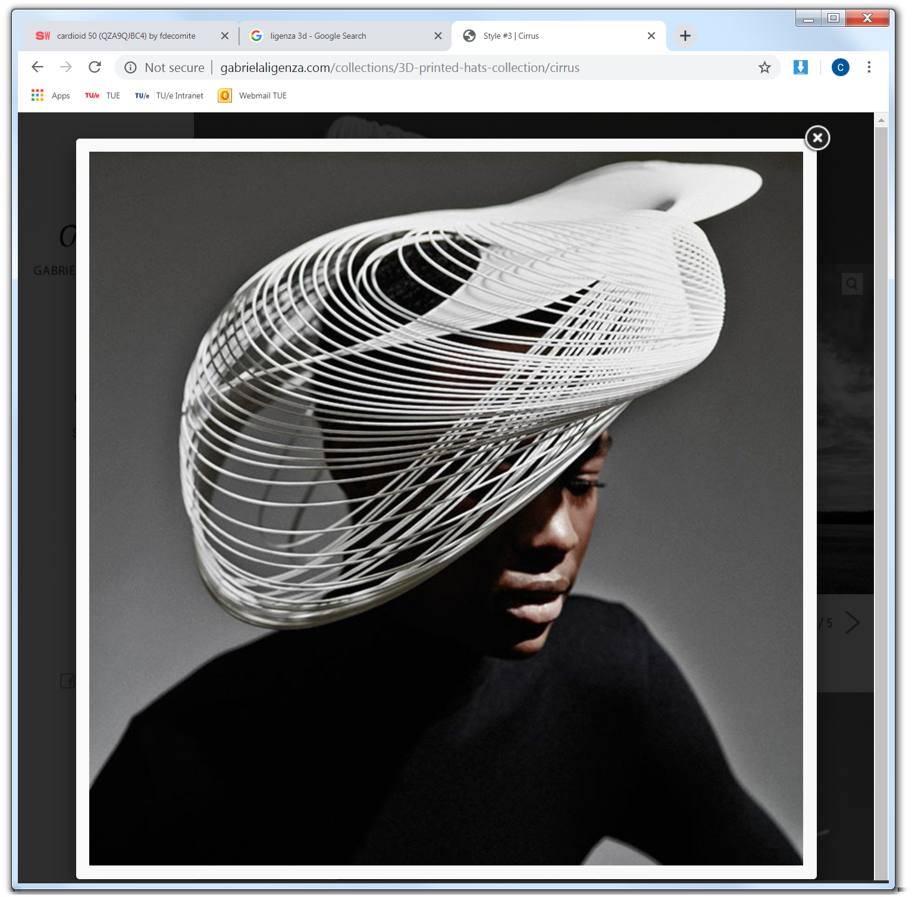
Inspiration: Website of milliner Gabriela Ligenza

Slide 5
Today’s lecture:
cardioids in “nature”
mathematics of cardioids
example in Processing
example continued: superstitching

Slide 6
Cardioids in “nature”
reflections in coffee cups
microphone directionality plots
main bulb of the Mandelbrot set

Slide 7
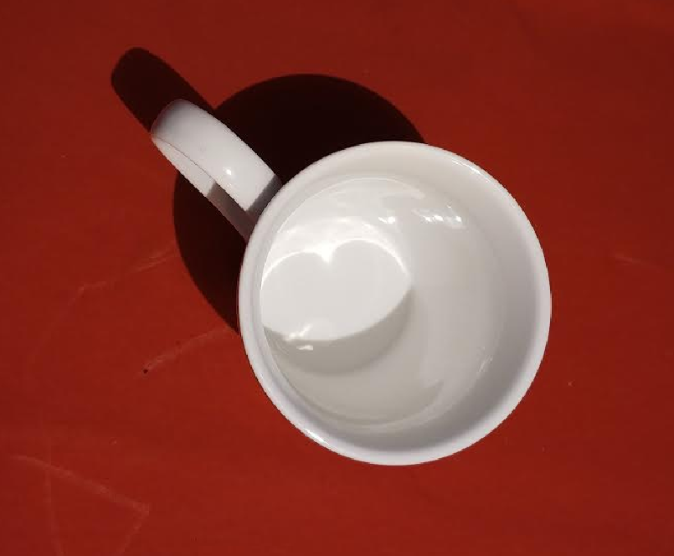
Cardioids in “nature”
Reflections in a conical coffee cup
Photo © Loe Feijs 2019

Slide 8
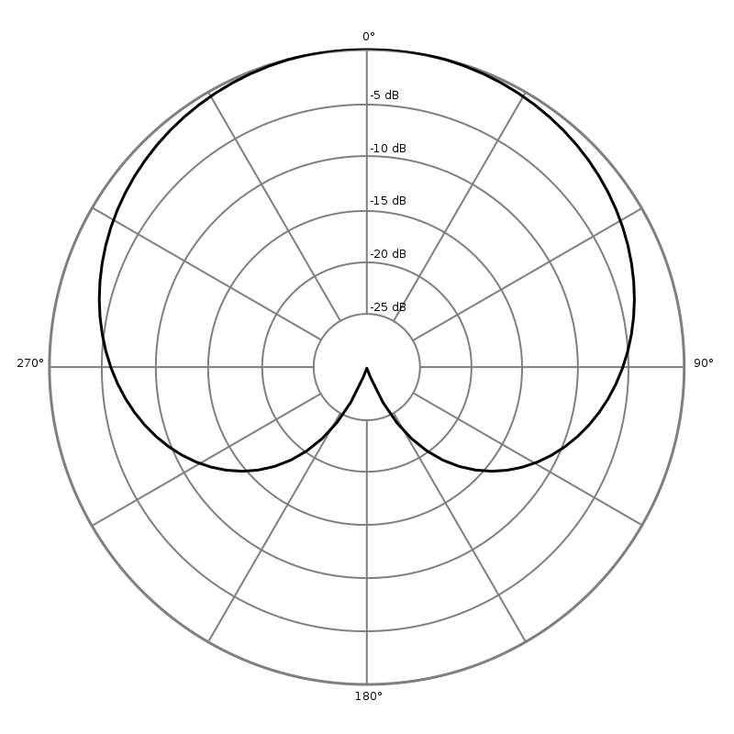

Cardioids in “nature”
A microphone's directionality or polar pattern indicates how sensitive it is to sounds arriving at different angles about its central axis. The polar pattern illustrated here represent the locus of points that produce the same signal level output in the microphone (wikipedia).
Photo left: Shure microphone 55S, Wikimedia (by Holger.Ellgaard). Diagram right: Cardioid.svg by Nicoguaro, Wikimedia

Slide 9
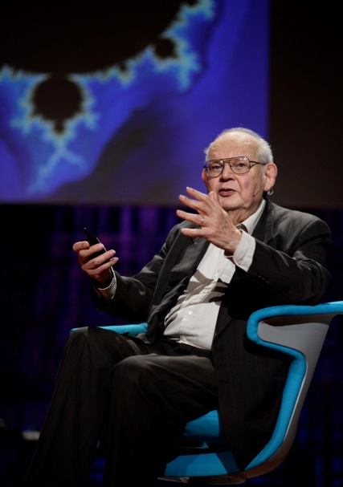
Cardioids
in “nature”
Mandelbrot set:
z = 0;
while (|z|< 2)
z = z² + c
Benoit Mandelbrot
Source (photo above): wikimedia and Flickr, cc-by-2.0 licence. (image right) © Loe Feijs and TU/e 2019, (Generated by Processing)

Slide 10
Mathematics of cardioids
Geometry:
heart shape
Equations:
polar equation
parametric equation
Calculus:
tangents
normals
speed

Slide 11
To be continued at the lightboard

Slide 12
Coding the Cardioid in Processing
divide 0..2π in steps of dt = 2π/steps
use the parametric equation
find points x,y in a single for loop
calculate derivatives dy/dt and dx/dt
next draw tangents and normals
play with these in search of aesthetics

Slide 13
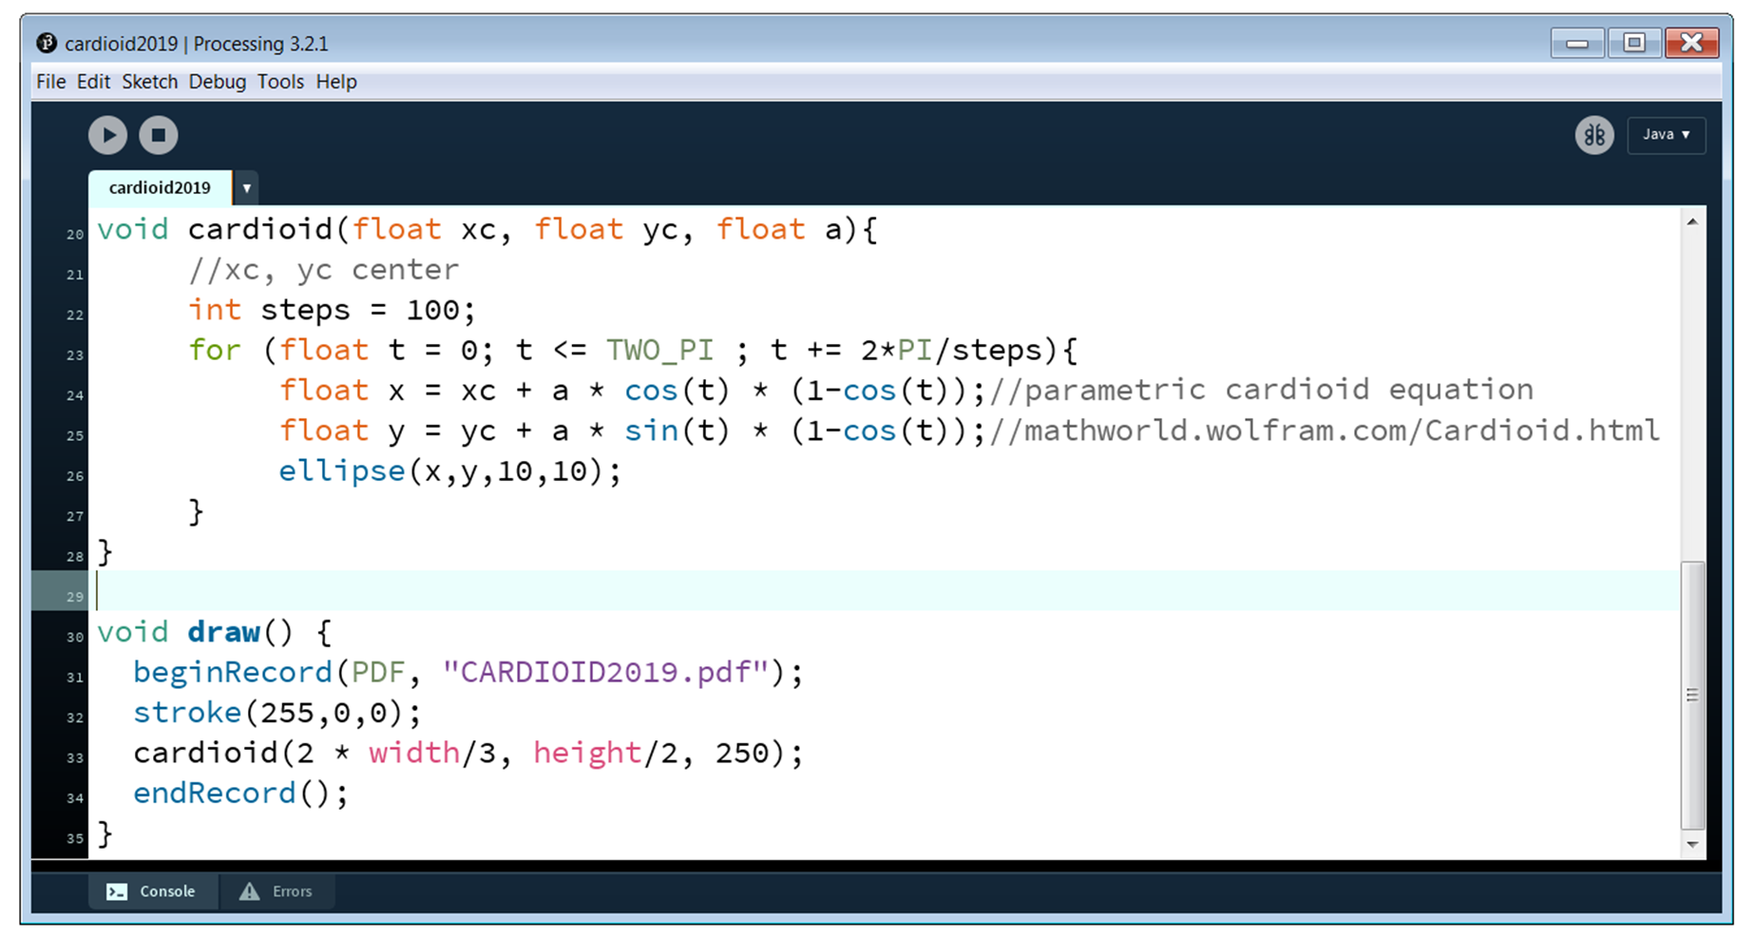

Slide 14
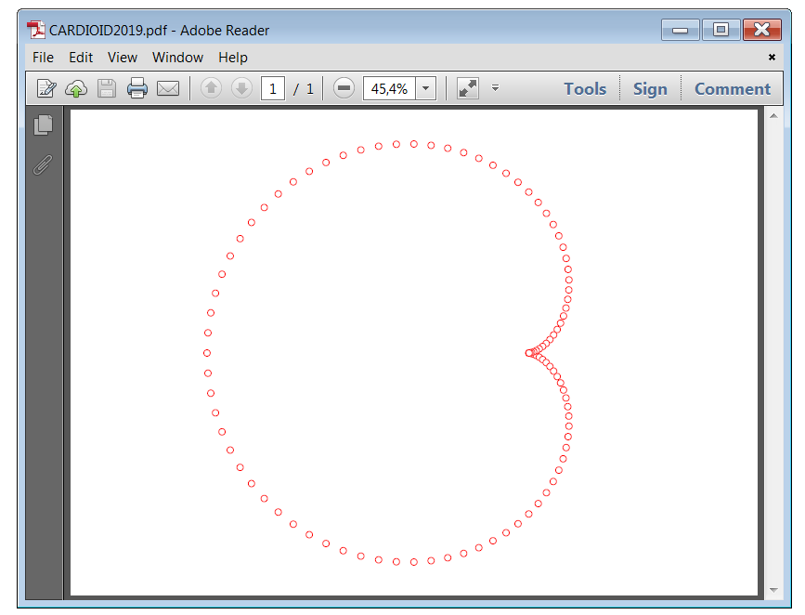
steps = 100

Slide 15
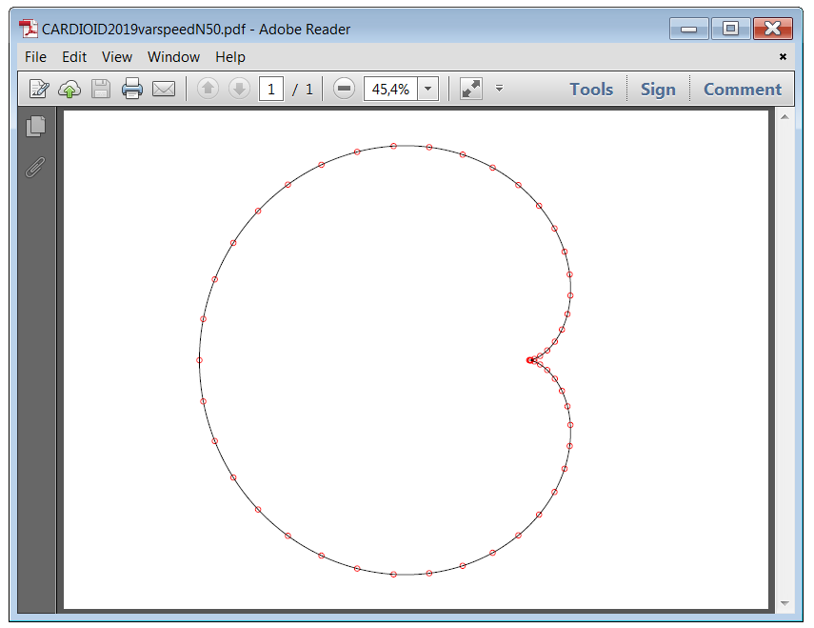
steps = 50

Slide 16
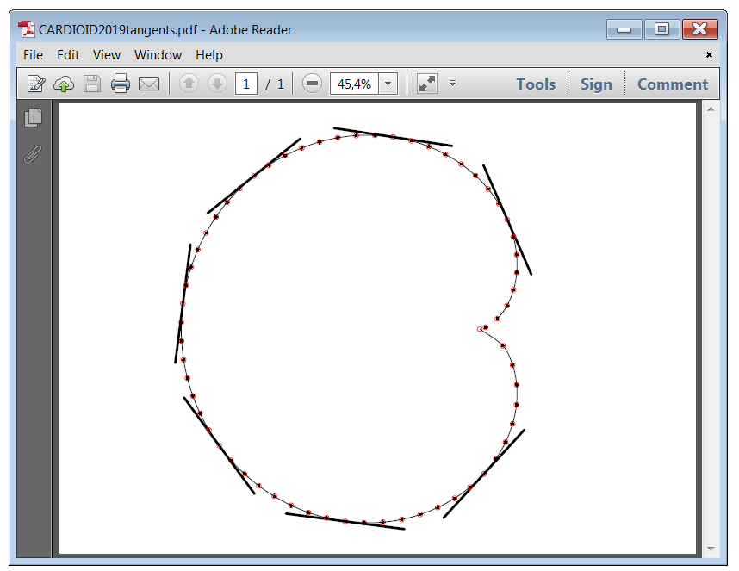
??

Slide 17
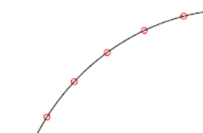
x + 1000,y + 1000*slope
tangent line
x ,y
x,y
x + 1000,y

Slide 18
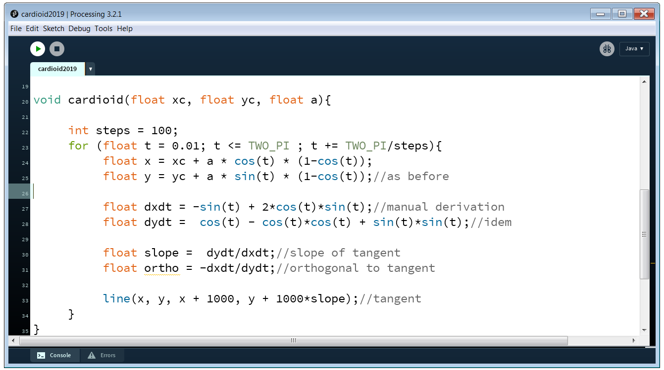

Slide 19
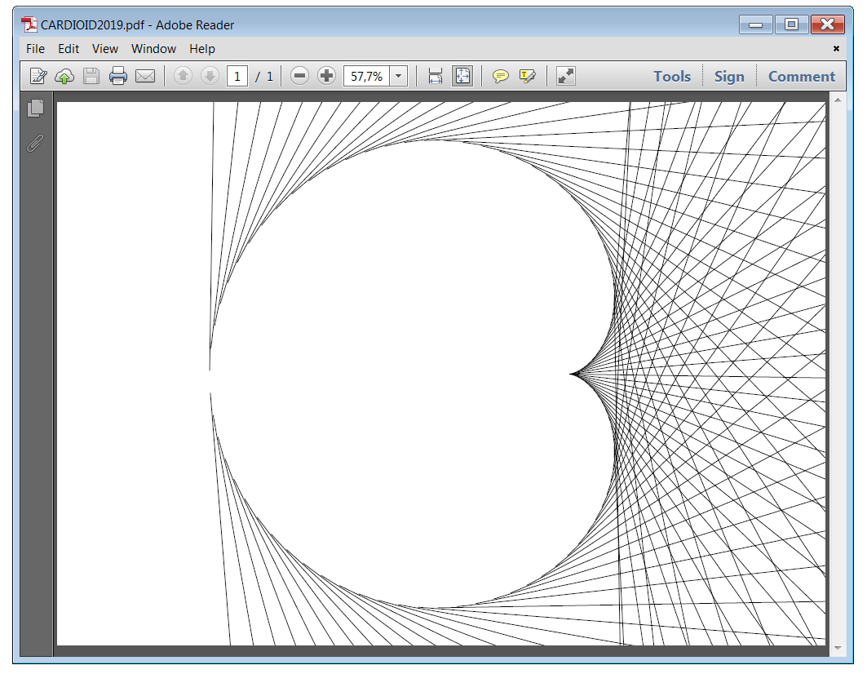
steps = 100

Slide 20
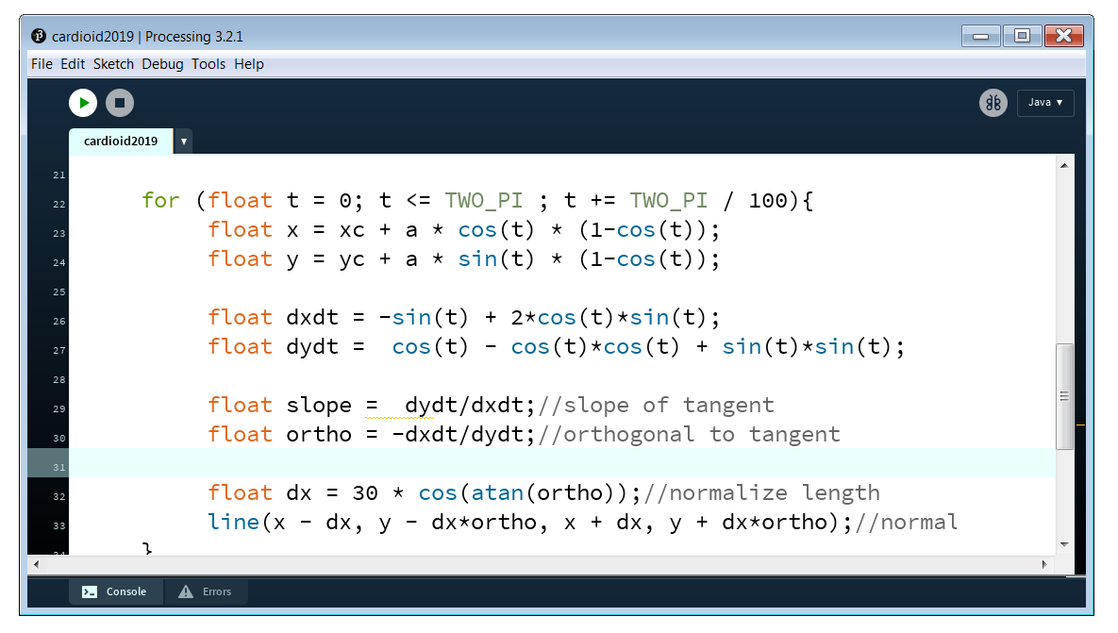

Slide 21
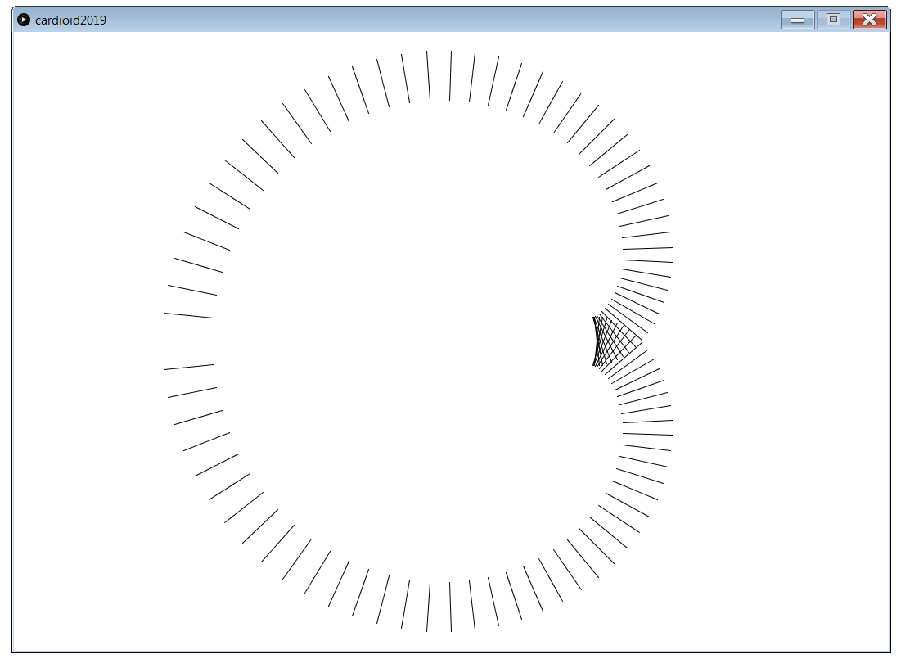
??

Slide 22
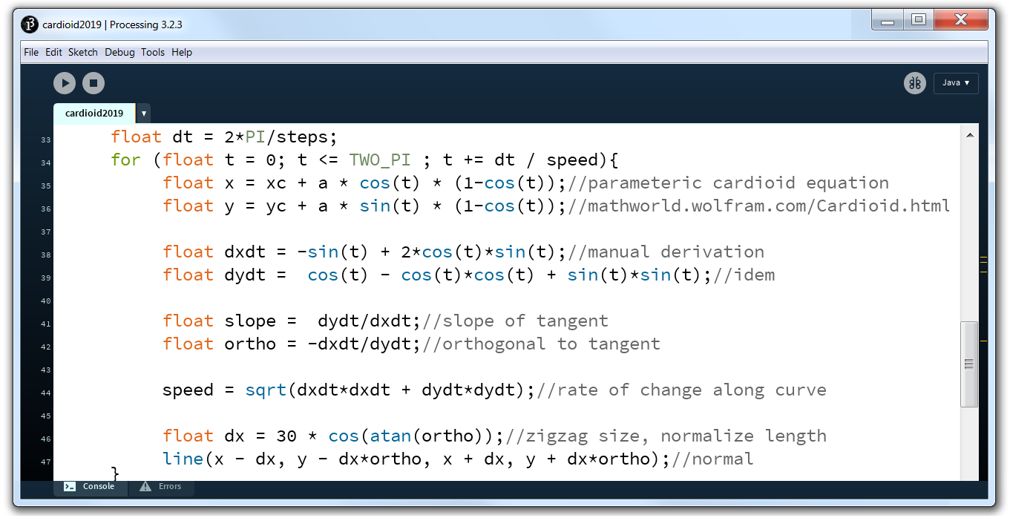

Slide 23
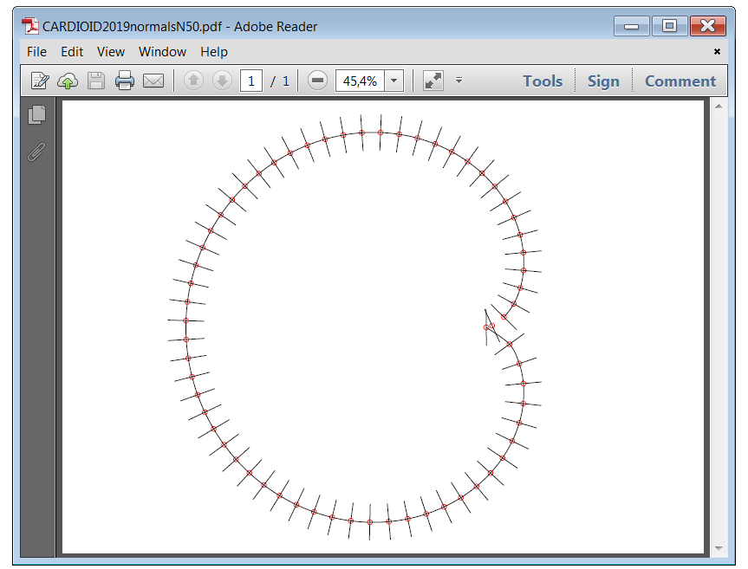

Slide 24
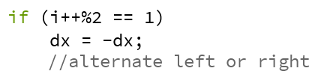
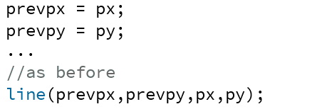

Slide 25
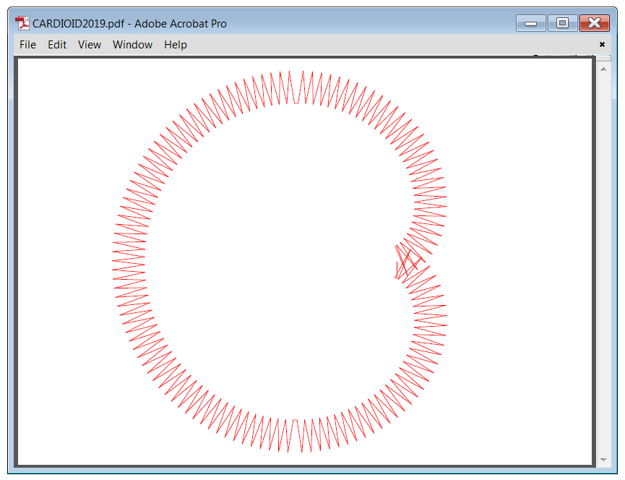
steps = 200

Slide 26
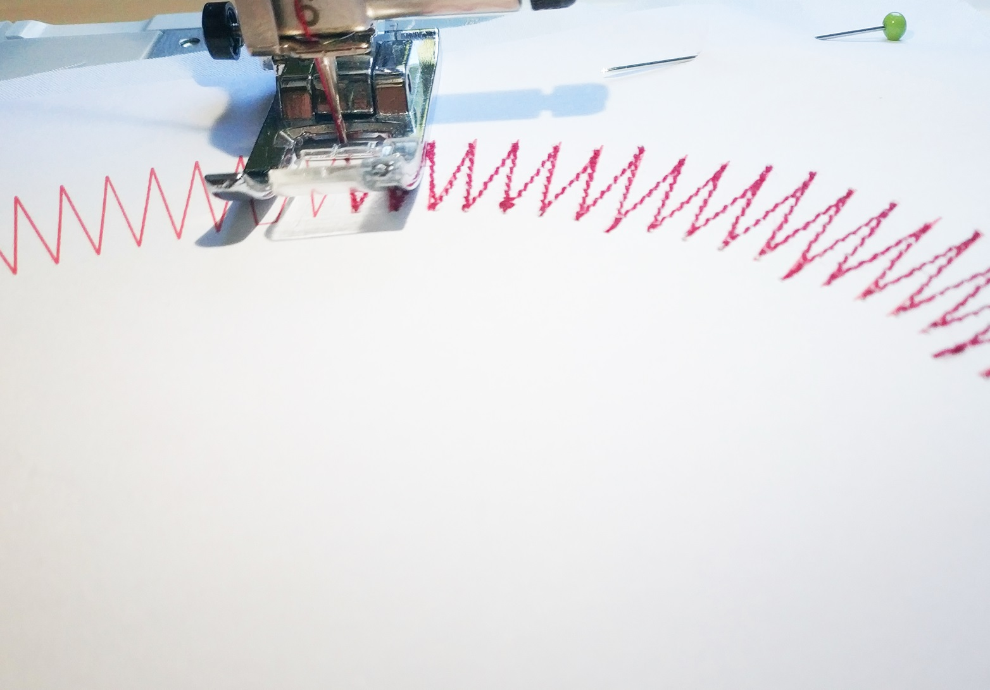

Slide 27
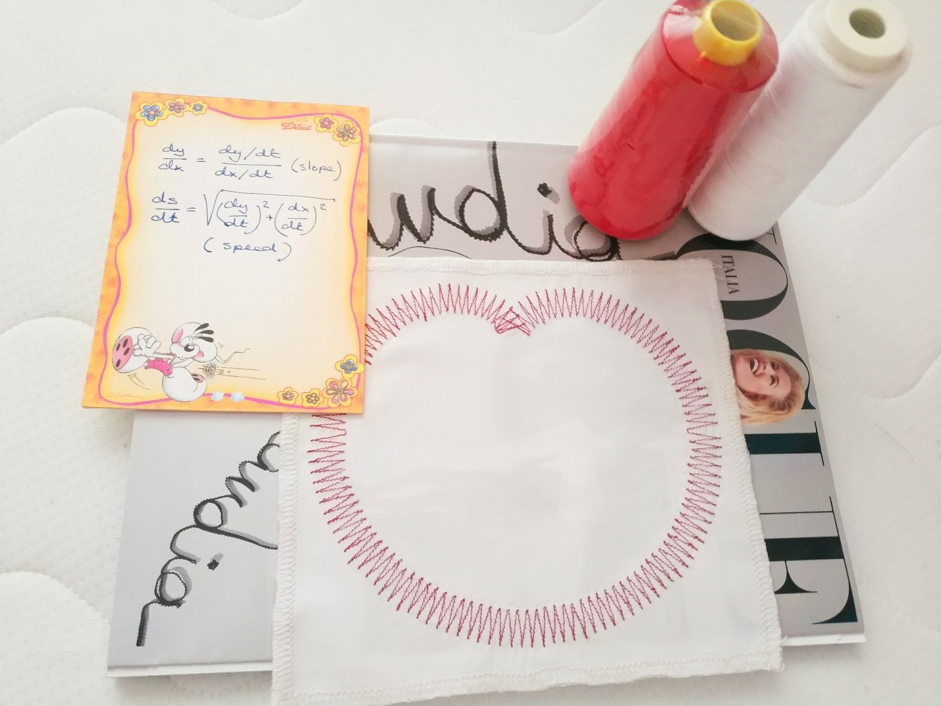

Slide 28
Recap and reflection
cardioids, like many curves, have a parametric equation
calculus can be used to find slopes, tangents and normals
dy/dx = dy/dt divided by dx/dt
calculus also gives the speed along the path
ds/dt = square root (dy/dt)² + (dx/dt)²
Processing produces vector graphics
for embroidery machines (soft things)
and laser cutters (for hard materials)

